Slide 1
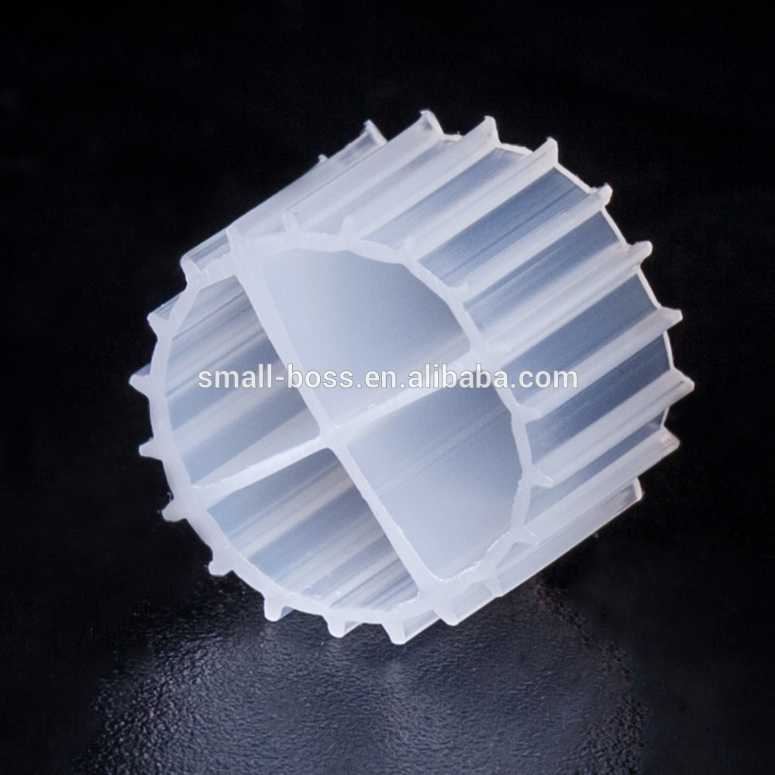
Biocarriers
James Hayes
August 30th, 2017

Slide 2
Index
(5-7) Biocarrier Shape Surface Area, Roughness, Fins/Ridges
(8-9) Biocarrier Size Thinner biofilms, more protection, balance of aerobic/anoxic
(10) Biocarrier Surface Area Better reactor performance, more biomass, oxygen depletion
(11) Biocarrier Concentration CFR, thinner and denser biofilm
(12) Biocarrier Density Similar to water’s density, movement
(13-15) Biocarrier Material Natural Materials, Polyethylene, Biodegradable
(16-19) Biodegradable Carriers Solid carbon source, enzymatic attack, no liquid substrate

Slide 3
(20-22) Advantages of Biodegradable Carriers No overdosing, porous, high SND rates
(23-25) Disadvantages of Biodegradable Carriers Expensive material, loses mass, high density
(26-27) Possible Solutions to Drawbacks Composite, mix of inert and biodegradable

Slide 4
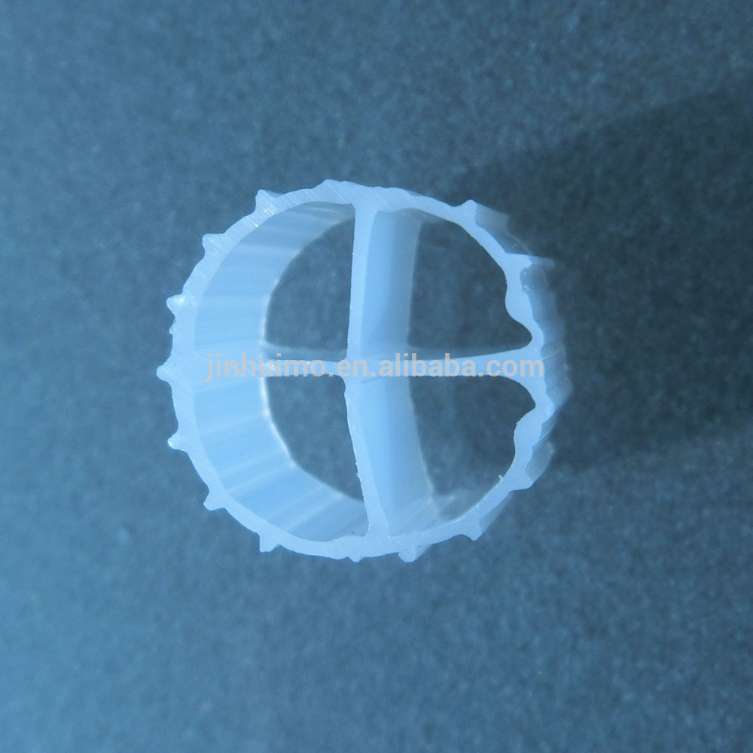
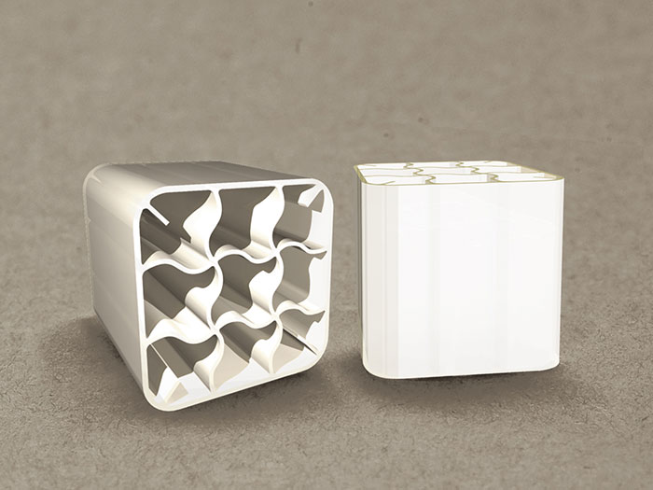
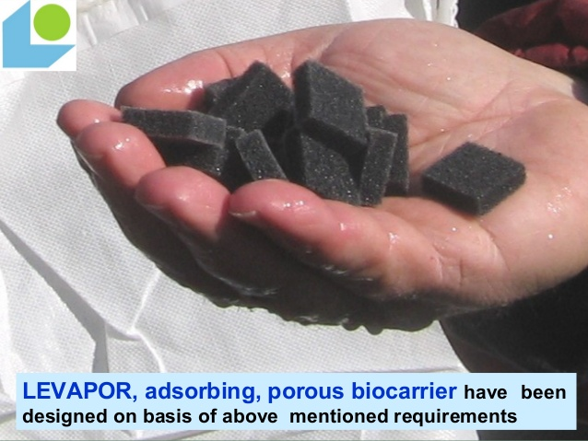
Biocarriers
In terms of wastewater treatment, a biocarrier is defined as a media support for biological agents (microorganisms) used to remove contaminants [1].

Slide 5
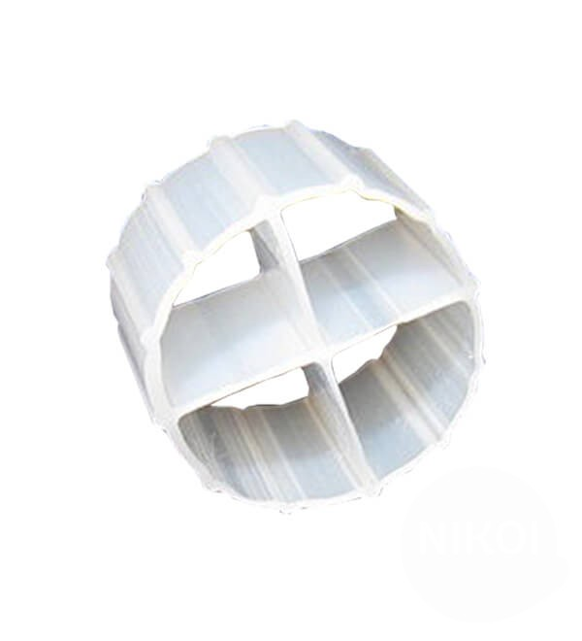
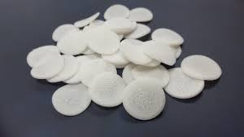
Biocarrier Shapes
One of the most common carrier shapes is cylindrical with internal crosses and external ridge like fins [2].
Carriers can also come in other shapes like spheres, rectangular prisms, or chips [3].
Plastic carriers in granule shapes have also been reported to be used as carriers [4].
Shapes that offer a high specific surface area tend to result in better removal efficiencies of the organic load in MBBR [2].
(Right): A cylindrical biocarrier with an internal cross.
(Left): A pile of chip shaped biocarriers.

Slide 6
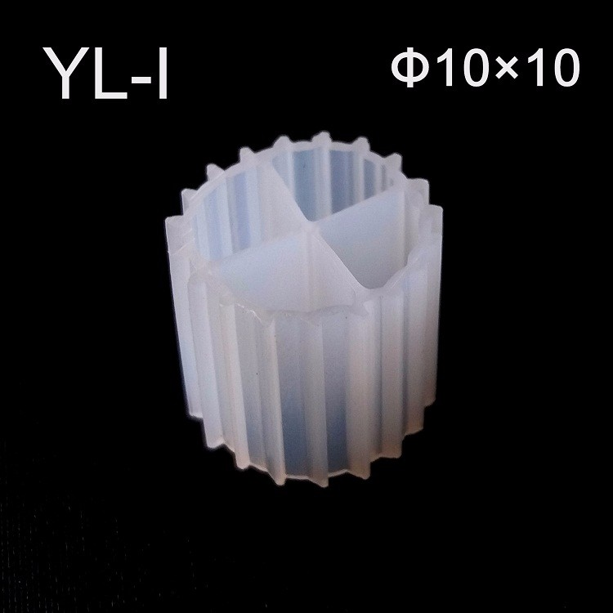
Simpler shapes tend to be cheaper, easier, and more practical to manufacture [3].
Carriers may also have helixes, internal fins, or other internal shapes which all help to increase surface area [5].
Roughness increases surface area and allows for more colonization/biofilm formation [6], [7].
Fins and ridges also minimize friction with other carriers and the reactor walls [5].
(Right): A biocarrier with small fins along its outer edge.

Slide 7
The carrier’s shape should allow for oxygen and nutrients to easily reach the microbes that need it. It should also protect microbes, especially with slow growing types such as nitrifiers [2].
Carriers with higher passage diameters can be beneficial as the carrier will be blocked by particles in the water less often [5].
Porous shapes can allow for anoxic conditions good for denitrification, which helps with simultaneous nitrification and denitrification (SND) on the carrier [8].
Shapes that allow the carrier to frequently be in motion can prevent clustering of the biomass in one part of the carrier [5].

Slide 8
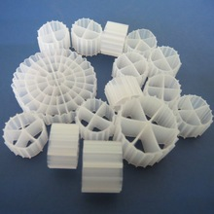
Biocarrier Size
Larger carriers are required in fewer number than smaller ones.
Larger diameter carriers may allow for thicker biofilms to grow as they often have more space for biofilms to do so. Smaller diameter carriers may have less space for biofilms to grow and thus might have thinner biofilms. These thinner biofilms may be less susceptible to breaking off since it has been reported that thinner biofilms allow for better transport of oxygen and carbon sources [2], [9]. Additionally, thinner biofilms have more biofilm activity [10].
(Right): The K1, K3, and K5 Kaldnes carriers. They are of ranging diameters.

Slide 9
It is crucial that a carrier has an optimum size that balances aerobic and anaerobic zones [11].
Smaller carriers may better protect microbes growing within them [9].
Carrier size may also affect the roughness and texture of the biofilms growing on them [11].

Slide 10
Biocarrier Surface Area
Increased effective surface area leads to more biomass and more exposed biofilm surface area, and this may increase reactor performance [12].
The increased and possibly thicker biomass due to higher surface area may lead to increased oxygen depletion [9]. Less oxygen may hinder nitrogen removal by preventing nitrifiers from getting oxygen, or could help it by providing anoxic zones for denitrification.
Possibly a higher risk of parts of the biofilm breaking off and causing fouling since biofilms may be thicker/more abundant and there is more oxygen depletion [9].

Slide 11
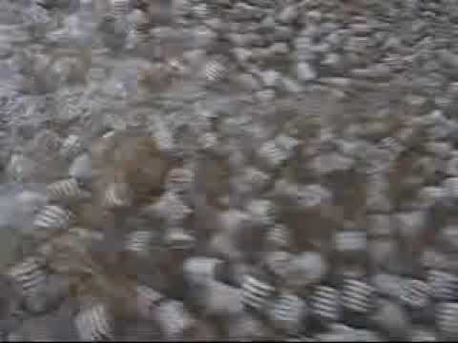
Biocarrier Concentration
A higher carrier filling ratio (CFR) leads to more collisions between carriers which leads to thinner biofilms [10]. The thinner and denser biofilms have more biofilm activity [10].
Common carrier filling ratios are between 60 and 70%, but CFRs below this are sometimes used [13].
(Left): A MBBR filled with carriers.

Slide 12
Biocarrier Density
A common density used for biocarriers is about .95 g/cm3, just below the density of water [2].
Carriers should have a density similar to that of water, even with attached biomass [14].
Carriers denser than water sink in the tank and may have a harder time moving around and getting oxygen.
Carriers less dense than water float toward the top of the tank. When biomass attaches to them, their density becomes closer to that of water, allowing them to move easier around the reactor tank [14].

Slide 13
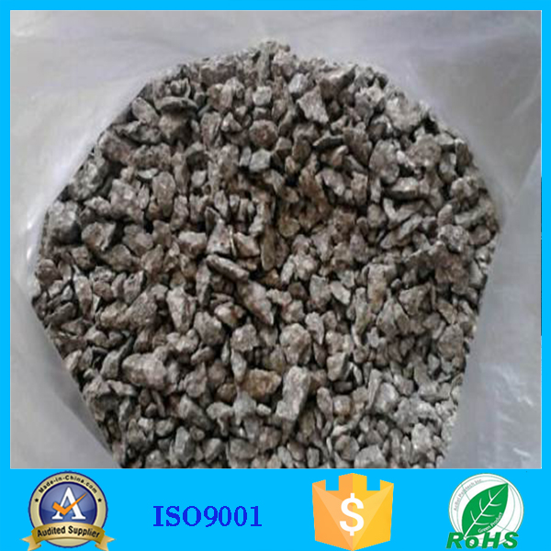
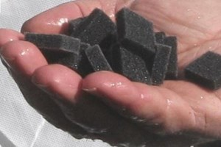
Biocarrier Materials
Biocarriers can be made out of a variety of substances such as glass, spongy material, metal mesh, gravel, plant material, stone, and plastics [15], [16].
Natural materials may be cheap to use, but have variable characteristics [3].
Polyethylene (PE), High Density Polyethylene (HDPE), and Polypropylene (PP) are very common carrier materials [2].
Porous materials, such as polyurethane foam, can be beneficial as they create anoxic zones for denitrification and more surface area [8].
(Left): A pile of gravel used as a carrier in a bioreactor.
(Right): A carrier made of a spongy material called polyurethane foam (PU).

Slide 14
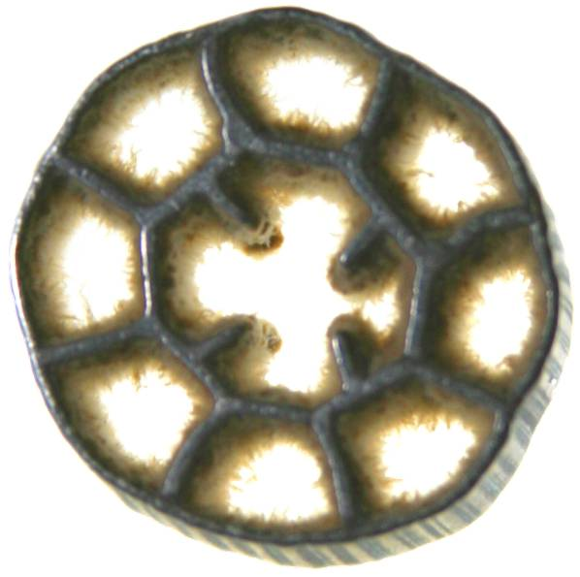
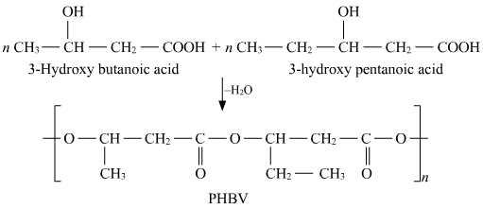
Carriers made of cheap and easy to process materials are more practical [5]
The carrier material should have some structural resistance so it does not deform [5].
Microbes tend to attach better to carriers made of organic materials, especially those made of microbial metabolites like poly(3-hydroxybutyrate-co-3-hydroxyvalerate) (PHBV) [5],[16].
(Left): A biocarrier with some attached biomass.
(Right): The synthesis of PHBV.

Slide 15
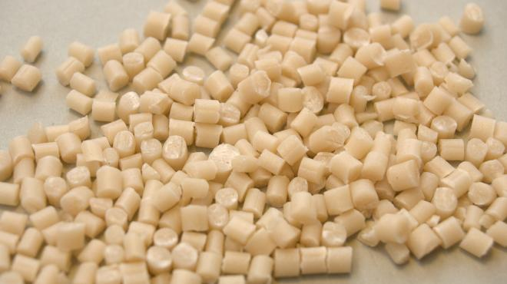
Some carrier materials are relatively inert, such as polyethylene, but others can be degraded by microbes in biofilm [18].
These include PCL (Polycaprolactone), PHB (Polyhydroxybutyrate), and PHBV. These organic compounds can also serve as a solid organic carbon source for the heterotrophic microbes [8], [17], [19].
(Right): Granules of Polyhydroxybutyrate (PHB).

Slide 16
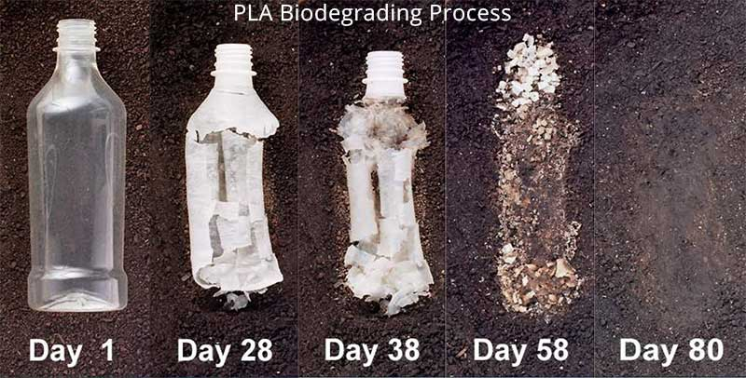
Biodegradable Carriers
Biodegradable Carriers are usually made of solid insoluble organic materials, however some biodegradable carbon sources like plant material may be more soluble [20], [21].
Common biodegradable materials used in biocarriers are PHB, PHBV, PLA (Polylactic acid), and PBS (Polybutylene succinate). These are all synthetic polymers or microbial metabolites [8], [17], [19], [22]
(Left): biodegradation of a PLA bottle over time.

Slide 17
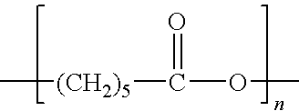
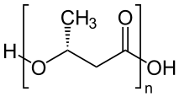
PCL (polycaprolactone): (C₆H₁₀O₂)_{n}, melting point 60°C [23].
PHB (polyhydroxybutyrate):(C₄H₆O₂)_{n}, a group of PHA (polyhydroxyalkanoate) polymers, melting point 175°C [18],[24].
PHBV (poly(3-hydroxybutyrate-co-3- hydroxyvalerate)): a PHV/PH3B copolymer, C₉H₁₈O₆, melting point 100-150°C [25], [26].
PBS (polybutylene succinate): (C₈H₁₂O₄)_{n}, melting point 115°C [27].
PLA (polylactic acid): (C₃H₄O₂)_{n}, melting point 157-170°C [28].
(Left): The structural formula for PCL.
(Right): The structural formula of PHB plastic [24].

Slide 18
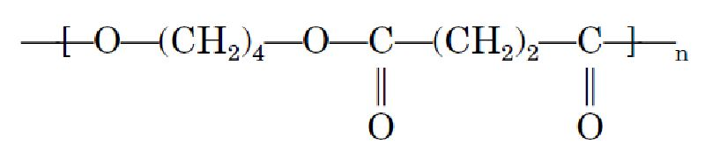
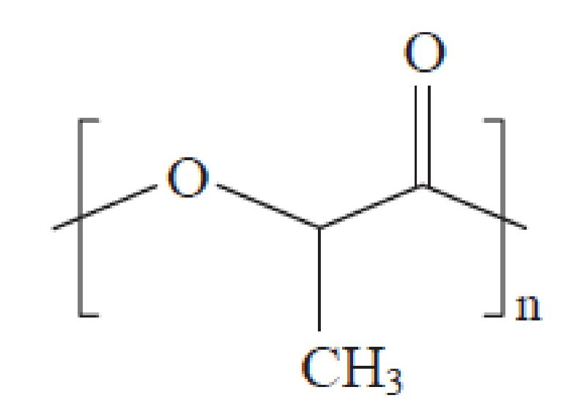
For microbes, namely denitrifiers, to get this carbon as a source of energy and to carry out heterotrophic denitrification, they must use enzymatic attack to degrade the carrier [29].
It has been reported that the compounds PHB and PHBV are very easily degraded, more so than other biodegradable materials like PCL and PLA [19], [30]. The uneven biodegradability in composites of these materials may lead to the creation of pores on the carrier surface. [30].
(Above): The structural formula of PBS.
(Right): The structural formula of PLA.

Slide 19
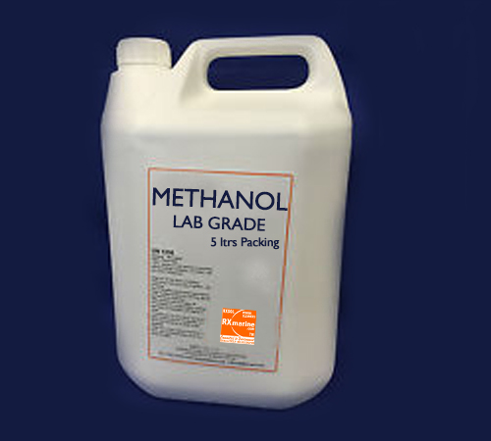
Heterotrophic denitrification utilizing solid carbon sources is called solid-phase denitrification [18], [31].
These solid organic carbon sources could be used opposed to liquid carbon sources like methanol, ethanol, and acetic acid [18].
(Left): Container of methanol, often used as a cheap organic carbon source in biofilm reactors. Adding too much may harm the microbes.

Slide 20
Advantages of Biodegradable Carriers
Liquid carbon sources are not necessary when biodegradable carriers are used. Using liquid substrates runs the risk of overdosing, but this isn’t a problem with biodegradable carriers since microbes obtain the carbon they need from the carrier using enzymatic attack [17], [29].
Additionally, it is easier to handle the system with solid rather than liquid substrates [8].
The biodegradable carrier is often insoluble before degradation, thus limiting dissolved organic carbon [22].

Slide 21
There is still a high TN removal rate as long as most of the mass remains [8].
High rates of simultaneous nitrification and denitrification (SND) [18], [30].
As the microbes biodegrade the carrier, it may become more porous, increasing the surface area and providing anoxic zones for denitrification [30], these zones may also protect denitrifiers from high external DO concentrations [22].

Slide 22
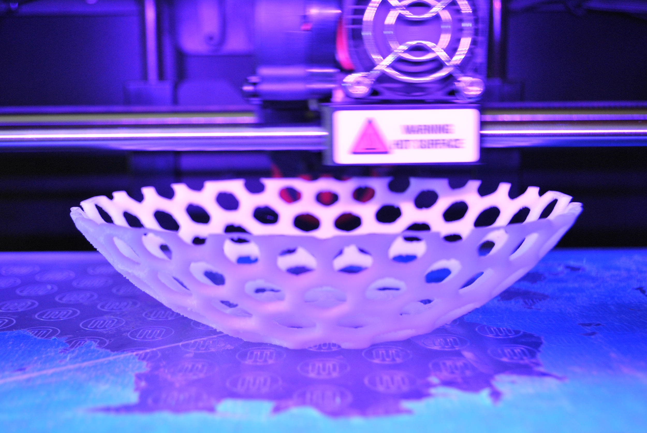
Making carriers out of materials like PLA is easy since PLA is commonly used for 3D printing. The higher cost of the materials can be mitigated by this cheaper manufacturing process (on a smaller scale) [28].
(Left): A piece of 3D printed PLA.

Slide 23
Disadvantages of Biodegradable Carriers
Most solid insoluble carbon sources, especially those most easily degraded, are more expensive than traditional liquid substrates like methanol or ethanol. The cost to benefit ratio is better for these liquid substrates [18].
If the solid substrate is at all soluble, as is the case with many natural materials, it can contribute to the dissolved organic carbon (DOC) content in the effluent [22]. It has been reported, though, that a DOC increase due to a soluble carrier material minimizes as the experiment goes on [19],[21].
The carrier is degraded by the microbes, so it loses mass over time [8]. It won’t last as long as more conventional carriers which can last upwards of 10 years [2].

Slide 24
Substrate | Price of substrate (€/kg substrate) | Consumption of substrate (kg substrate/kg N-NO3−) | Costs of denitrification (€/kg N-NO3−)
Methanol: CH3OH | 1.00 | 2.08–3.98 | 2.0–4.0
Ethanol: C2H5OH | 1.20 | 2.0 | 2.4
Acetic acid: CH3COOH | 2.40 | 3.5 | 8.0
PCL (C6H10O2)n | 5.00 | 1.33–1.77 | 6.6–8.9
PHB (C4H6O2)n | 10.00 | 2.1–2.7 | 21.0–37.2
(Above): The price, consumption rate, and cost of denitrification for various organic carbon sources. Adapted from Boley et al., 2000 [18].

Slide 25
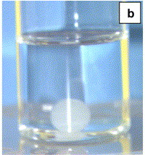
The amount of carrier material left has a strong influence on the TN removal rate in a biofilm reactor since it can limit biofilm growth [8].
Many materials used in biodegradable carriers have high densities above that of water. For example, PCL has a density of 1.145 g/cm3 [32], PHB has a density of 1.25 /cm3 [33], PLA has a density of 1.25 g/cm3 [34], PBS has one of 1.26 g/cm3 [27], and PHBV has a density of 1.25 g/cm3 [35]. This means they might sink and have movement problems if not combined with a less dense material or have a lower infill percentage.
(Left): A bead made of PHBV/Toluene gel that has sunk to the bottom of a container filled with a toluene solution (toluene density 0.867 g/cm3) [36].

Slide 26
Possible Solutions to the Drawbacks
Using a composite of a cheaper, less degradable polymer and a more expensive, more easily degradable polymer can lower costs and allow for more pores since the microbes will more likely degrade the polymer which is more easily biodegraded [19], [30].
Using cheaper, natural biodegradable materials like plastics made of plant material such as corn, though these may be more soluble and could increase DOC [20].
Using a mix of biodegradable carriers and inert (PE or HDPE) carriers may keep the reactor working well even as the biodegradable carriers lose much mass.

Slide 27
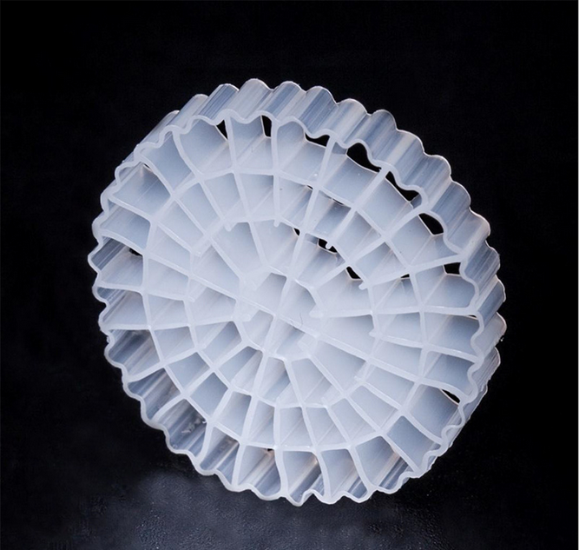
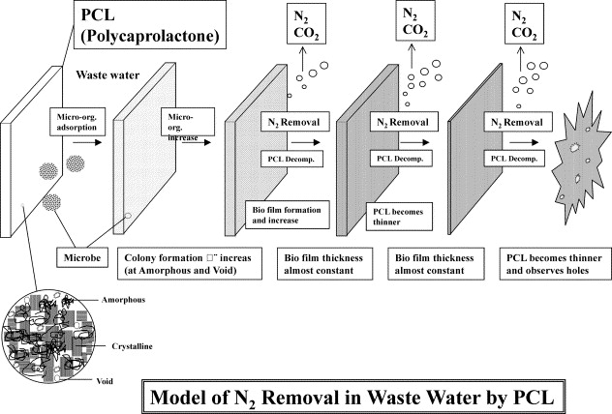
Using carriers with more mass would allow them to be more viable for longer periods of time, but this might present a problem in either size or density.
3D printing, rather than injection molding, can mitigate the higher costs of the biodegradable carriers due to the lower startup manufacturing costs [37].
Mixing these biodegradable materials with less dense, inert materials may lower the density to acceptable levels.
(Right): A high density polyethylene carrier. Commonly used and cheaper than biodegradable carriers, although liquid carbon substrates may be necessary.
(Left): An image of a PCL carrier losing mass as a biofilm forms and removes nitrogen [38].

Slide 28
References
[1] Yoon, S. (2016, March 29). Biocarriers to reduce membrane fouling. Retrieved August 28, 2017, from http://onlinembr.info/biocarriers-to-reduce-membrane-fouling/
[2] Barwal, A., & Chaudhary, R. (2014). To study the performance of biocarriers in moving bed biofilm reactor (MBBR) technology and kinetics of biofilm for retrofitting the existing aerobic treatment systems: a review. Reviews in Environmental Science and Bio/Technology, 13(3), 285-299. doi:10.1007/s11157-014-9333-7
[3] Elliot, O., Gray, S., Mcclay, M., Nassief, B., Nunnelley, A., Vogt, E., . . . Carrano, A. L. (2017). Design and Manufacturing of High Surface Area 3D-Printed Media for Moving Bed Bioreactors for Wastewater Treatment. Journal of Contemporary Water Research & Education, 160(1), 144-156. doi:10.1111/j.1936-704x.2017.03246.x
[4] Chu, L., & Wang, J. (2013). Denitrification performance and biofilm characteristics using biodegradable polymers PCL as carriers and carbon source. Chemosphere, 91(9), 1310-1316. doi:10.1016/j.chemosphere.2013.02.064
[5] Huerta GM, Prended-Gero B, Ortega-Fernandez F, Mesa-Fernandez JM (2009) Design of a carrier for wastewater treatment using moving bed bioreactor. In: Proceedings of the 2nd International Conference on Environmental and Geological Science and Engineering, Trasilvania University of Brasav, Romania, p 44–49
[6] Donlan, R. M. (2002). Biofilms: Microbial Life on Surfaces. Emerging Infectious Diseases, 8(9), 881-890. doi:10.3201/eid0809.020063
[7] Dong, Y. et al. A Novel Bio-carrier Fabricated Using 3D Printing Technique for Wastewater Treatment. Sci. Rep. 5, 12400; doi: 10.1038/srep12400 (2015).

Slide 29
[8] Walters, E., Hille, A., He, M., Ochmann, C., & Horn, H. (2009). Simultaneous nitrification/denitrification in a biofilm airlift suspension (BAS) reactor with biodegradable carrier material. Water Research, 43(18), 4461-4468. doi:10.1016/j.watres.2009.07.005
[9] Byoung-In, S., Yoo, E., Kim, B. J., & Rittmanb, B. E. (2008). Effect of Carrier Size on the Performance of a Three-Phase Circulating-Bed Biofilm Reactor for Removing Toluene in Gas Stream. Journal of Microbiology and Biotechnology, 18(6), 1121-1129. Retrieved July 26, 2017, from http://www.jmb.or.kr/journal/viewJournal.html?year=2008&vol=18&num=6&page=1121
[10] Wang, R., Wen, X., & Qian, Y. (2005). Influence of carrier concentration on the performance and microbial characteristics of a suspended carrier biofilm reactor. Process Biochemistry, 40(9), 2992-3001. doi:10.1016/j.procbio.2005.02.024
[11] Ahmad, M., Liu, S., Mahmood, N., Mahmood, A., Ali, M., Zheng, M., & Ni, J. (2017). Effects of porous carrier size on biofilm development, microbial distribution and nitrogen removal in microaerobic bioreactors. Bioresource Technology, 234, 360-369. doi:10.1016/j.biortech.2017.03.076
[12] Ødegaard, H., Gisvold, B., & Strickland, J. (2000). The influence of Carrier Size and Shape in the Moving Bed Biofilm Process. International Water Association Publishing, 41(4-5), 383-391. Retrieved July 26, 2017, from http://wst.iwaponline.com/content/41/4-5/383
[13] Leiknes, T., & Ødegaard, H. (2001). MOVING BED BIOFILM MEMBRANE REACTOR (MBB-M-R): CHARACTERISTICS AND POTENTIALS OF A HYBRID PROCESS DESIGN FOR COMPACT WASTEWATER TREATMENT PLANTS . Retrieved August 9, 2017, from https://www.researchgate.net/publication/228483809_Moving_bed_biofilm_membrane_reactor_MBB-MR_Characteristics_and_potentials_of_a_hybrid_process_design_for_compact_wastewater_treatment_plants.
[14] Kriklavova L, Lederer T (2010) The use of nanofibre carriers in biofilm reactor for the treatment of industrial wastewaters, Nanocon, Olomouc, Ceska Republika, 12–14th Oct

Slide 30
[15] Ramírez-López, E., Corona-Hernández, J., Dendooven, L., Rangel, P., & Thalasso, F. (2003). Characterization of five agricultural by-products as potential biofilter carriers. Bioresource Technology, 88(3), 259-263. doi:10.1016/s0960-8524(02)00315-2
[16] Hermanowicz, S. W., & Ganczarczyk, J. J. (1983). Some fluidization characteristics of biological beds. Biotechnology and Bioengineering, 25(5), 1321-1330. doi:10.1002/bit.260250512
[17] Hiraishi, A., & Khan, S. T. (2003). Application of polyhydroxyalkanoates for denitrification in water and wastewater treatment. Applied Microbiology and Biotechnology, 61(2), 103-109. doi:10.1007/s00253-002-1198-y
[18] Boley, A., Müller, W., & Haider, G. (2000). Biodegradable polymers as solid substrate and biofilm carrier for denitrification in recirculated aquaculture systems. Aquacultural Engineering, 22(1-2), 75-85. doi:10.1016/s0144-8609(00)00033-9
[19] Wu, W., Yang, F., & Yang, L. (2012). Biological denitrification with a novel biodegradable polymer as carbon source and biofilm carrier. Bioresource Technology, 118, 136-140. doi:10.1016/j.biortech.2012.04.066
[20] Le, H. T., Jantarat, N., Khanitchaidecha, W., Ratananikom, K., & Nakaruk, A. (2016). Utilization of Waste Materials for Microbial Carrier in Wastewater Treatment. BioMed Research International, 2016, 1-6. doi:10.1155/2016/6957358
[21] Xu, Z., Shao, L., Chu, H., & Yao, Y. (2009). Biological Denitrification Using Corncobs as a Carbon Source and Biofilm Carrier. Water Environment Research,81(3), 242-247. Retrieved July 31, 2017, from http://www.jstor.org/stable/40575346
[22] Luo, G., Li, L., Liu, Q., Xu, G., & Tan, H. (2014). Effect of dissolved oxygen on heterotrophic denitrification using poly(butylene succinate) as the carbon source and biofilm carrier. Bioresource Technology, 171, 152-158. doi:10.1016/j.biortech.2014.08.055
[23] Polycaprolactone, MW 43000. (n.d.). Retrieved August 07, 2017, from http://www.polysciences.com/default/catalog-products/polycaprolactone-polymer/

Slide 31
[24] Polyhydroxybutyrate. (2017, July 28). Retrieved August 07, 2017, from https://en.wikipedia.org/wiki/Polyhydroxybutyrate
[25] National Center for Biotechnology Information. PubChem Compound Database; CID=107801, https://pubchem.ncbi.nlm.nih.gov/compound/107801 (accessed Aug. 7, 2017).
[26] Wang, Y., Chen, R., Cai, J., Liu, Z., Zheng, Y., Wang, H., . . . He, N. (2013). Biosynthesis and Thermal Properties of PHBV Produced from Levulinic Acid by Ralstonia eutropha. PLoS ONE, 8(4). doi:10.1371/journal.pone.0060318
[27] Polybutylene succinate. (2017, July 06). Retrieved August 07, 2017, from https://en.wikipedia.org/wiki/Polybutylene_succinate
[28] Rogers, T. (n.d.). Everything You Need To Know About Polylactic Acid (PLA). Retrieved August 07, 2017, from https://www.creativemechanisms.com/blog/learn-about-polylactic-acid-pla-prototypes
[29] Chu, L., & Wang, J. (2011). Nitrogen removal using biodegradable polymers as carbon source and biofilm carriers in a moving bed biofilm reactor. Chemical Engineering Journal, 170(1), 220-225. doi:10.1016/j.cej.2011.03.058
[30] Hille, A., He, M., Ochmann, C., Neu, T. R., & Horn, H. (2009). Application of two component biodegradable carriers in a particle-fixed biofilm airlift suspension reactor: development and structure of biofilms. Bioprocess and Biosystems Engineering, 32(1), 31-39. doi:10.1007/s00449-008-0217-
[31] Shen, Z., Zhou, Y., Hu, J., & Wang, J. (2013). Denitrification performance and microbial diversity in a packed-bed bioreactor using biodegradable polymer as carbon source and biofilm support. Journal of Hazardous Materials, 250-251, 431-438. doi:10.1016/j.jhazmat.2013.02.026
[32] Polycaprolactone. (2017, August 07). Retrieved August 08, 2017, from https://en.wikipedia.org/wiki/Polycaprolactone

Slide 32
[33] W. (n.d.). Polyhydroxybutyrate - Biopolymer ( PHB ). Retrieved August 08, 2017, from http://www.goodfellow.com/E/Polyhydroxybutyrate-Biopolymer-Polymer.html
[34] Is It Filament Weight or Length? (2015, October 6). Retrieved August 08, 2017, from http://www.fabbaloo.com/blog/2015/9/27/is-it-filament-weight-or-length
[35] Richards, E., Rizvi, R., Chow, A., & Naguib, H. (2008). Biodegradable Composite Foams of PLA and PHBV Using Subcritical CO2. Journal of Polymers and the Environment, 16(4), 258-266. Retrieved August 9, 2017, from https://link.springer.com/article/10.1007/s10924-008-0110-y.
[36] Pich, A., Schiemenz, N., Corten, C., & Adler, H. P. (2006). Preparation of poly(3-hydroxybutyrate-co-3-hydroxyvalerate) (PHBV) particles in O/W emulsion. Polymer, 47(6), 1912-1920. doi:10.1016/j.polymer.2006.01.038
[37] Langnau, L., Says, L. M., & Says, L. L. (2016, March 14). 3D printing versus injection molding. Retrieved August 30, 2017, from http://www.makepartsfast.com/3d-printing-versus-injection-molding/
[38] Honda, Y., & Osawa, Z. (2002). Microbial denitrification of wastewater using biodegradable polycaprolactone. Polymer Degradation and Stability, 76(2), 321-327. doi:10.1016/s0141-3910(02)00028-9

